Slide 1
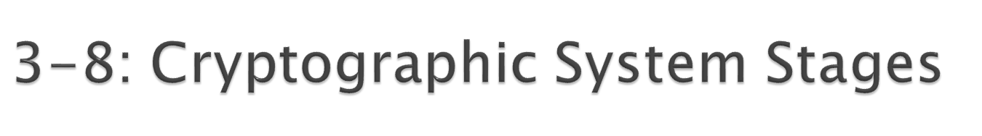
Cryptographic Systems
  Encryption for confidentiality is only one cryptographic protection
  Individual users and corporations cannot be expected to master these many aspects of cryptography
  Consequently, crypto protections are organized into complete cryptographic systems that provide a broad set of cryptographic protection
1
Copyright Pearson Prentice-Hall 2009

Slide 2
Cryptographic Systems
  Two parties first agree upon a particular cryptographic system to use
  Each cryptographic system dialogue begins with three brief hand-shaking stages
  The two parties then engage in cryptographically protected communication
      This ongoing communication stage usually constitutes nearly all of the dialogue
Copyright Pearson Prentice-Hall 2009

Slide 3

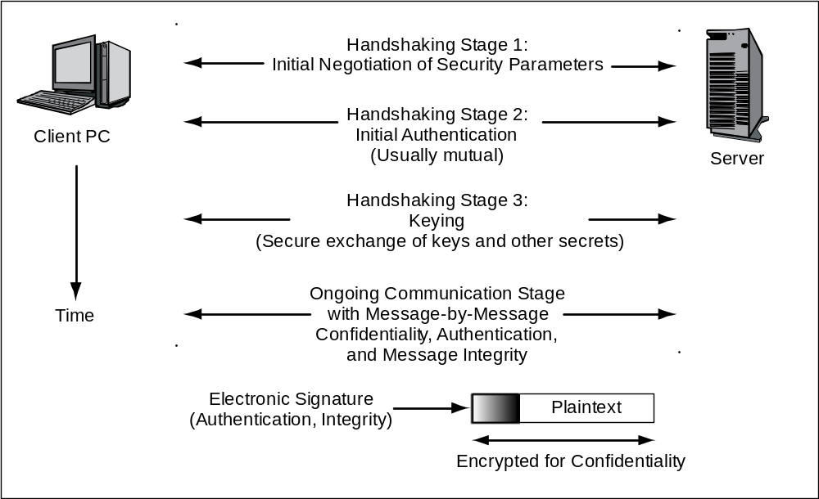
Time
Copyright Pearson Prentice-Hall 2009

Slide 4
Copyright Pearson Prentice-Hall 2009

Slide 5
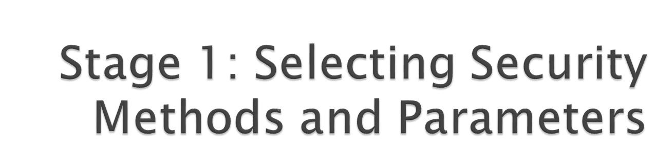
Selecting methods and parameters
Authentication
Keying (the secure exchange of secrets)
Ongoing communication
Copyright Pearson Prentice-Hall 2009

Slide 6
Cipher Suite | Key Negotiation | Digital Signature Method | Symmetric Key Encryption Method | Hashing Method for HMAC | Strength
NULL_WITH_NULL_NULL | None | None | None | None | None
RSA_EXPORT_WITH_ RC4_40_MD5 | RSA export strength (40 bits) | RSA export strength (40 bits) | RC4 (40-bit key) | MD5 | Weak
RSA_WITH_DES_CBC_ SHA | RSA | RSA | DES_CBC | SHA-1 | Stronger but not very strong
DH_DSS_WITH_3DES_ EDE_CBC_SHA | Diffie-Hellman | Digital Signature Standard | 3DES_ EDE_CBC | SHA-1 | Strong
RSA_WITH_AES_256_CBC_SHA256 | RSA | RSA | AES 256 bits | SHA-256 | Very strong
Copyright Pearson Prentice-Hall 2009

Slide 7
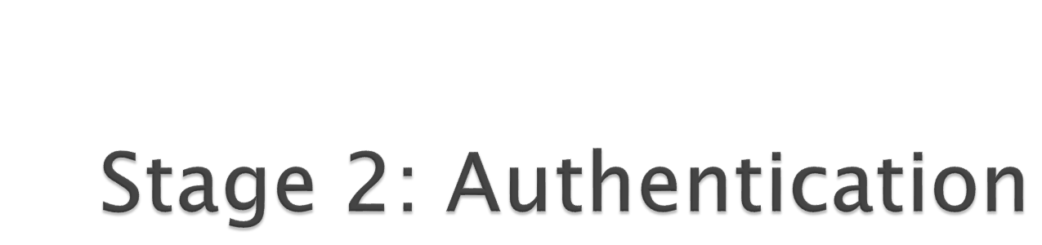
Selecting methods and parameters
Authentication
Keying (the secure exchange of secrets)
Ongoing communication
Copyright Pearson Prentice-Hall 2009

Slide 8
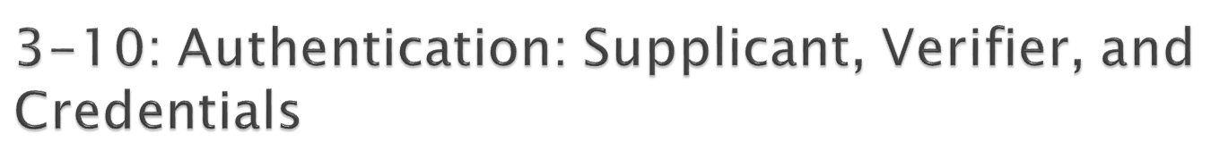



Supplicant:
Wishes to prove its identity
Credentials
Proofs of identity (password, etc.)
Verifier:
Tests the credentials, accepts or rejects the supplicant
Copyright Pearson Prentice-Hall 2009

Slide 9

Hashing
  A hashing algorithm is applied to a bit string of any length
  The result of the calculation is called the hash
  For a given hashing algorithm, all hashes are the same short length
Hashing
Algorithm
Bit string of any length
Hash: bit string of small fixed length
Copyright Pearson Prentice-Hall 2009

Slide 10
Hashing versus Encryption
Characteristic | Encryption | Hashing
Result length | About the same length as the plaintext | Short fixed length regardless of message length
Reversible? | Yes. Decryption | No. There is no way to get from the short hash back to the long original message
Copyright Pearson Prentice-Hall 2009

Slide 11
Hashing Algorithms
  MD5 (128-bit hashes)
  SHA-1 (160-bit hashes)
  SHA-224, SHA-256, SHA-384, and SHA-512 (name gives hash length in bits)
  Note: MD5 and SHA-1 should not be used because have been shown to be unsecure
Copyright Pearson Prentice-Hall 2009

Slide 12

Selecting methods and parameters
Authentication
Keying (the secure exchange of secrets)
Ongoing communication
Copyright Pearson Prentice-Hall 2009

Slide 13

There are two types of ciphers used for confidentiality
  In symmetric key encryption for confidentiality, the two sides use the same key
    For each dialogue (session), a new symmetric key is generated: the symmetric session key
  In public key encryption, each party has a public key and a private key that are never changed
    A person’s public key is available to anyone
    A person keeps his or her private key secret
Copyright Pearson Prentice-Hall 2009

Slide 14

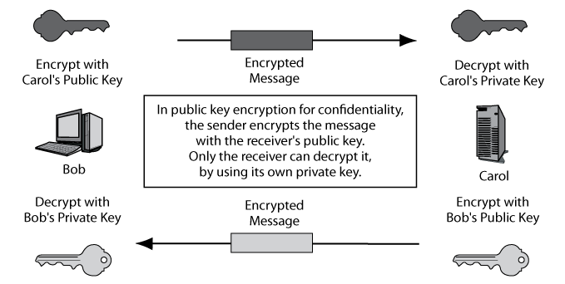
Copyright Pearson Prentice-Hall 2009

Slide 15
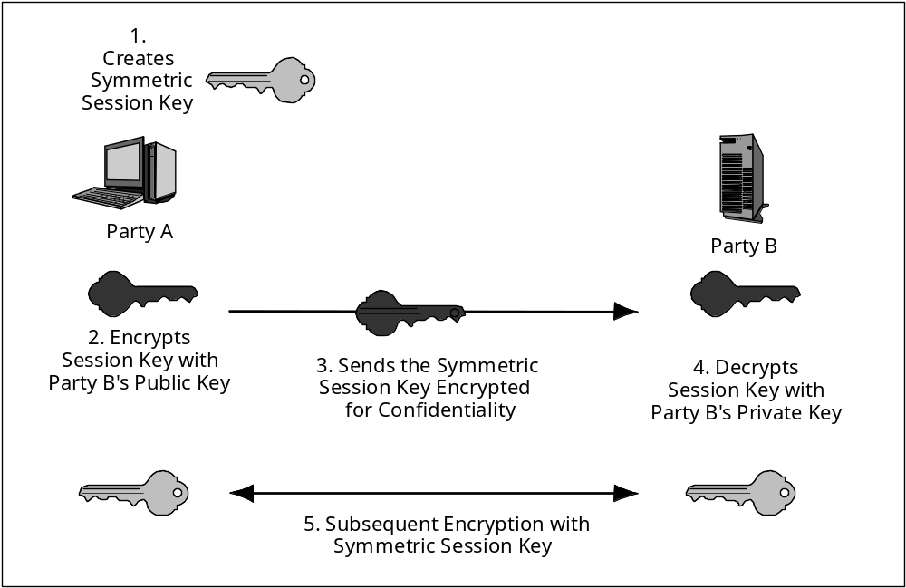
Copyright Pearson Prentice-Hall 2009

Slide 16

The two parties exchange parameters p and g
Each uses a number that is never shared explicitly to compute a second number
  Each sends the other their second number
Each does another computation on the second computed number
Both get the third number, which is the key
All of this communication is sent in the clear
Copyright Pearson Prentice-Hall 2009

Slide 17
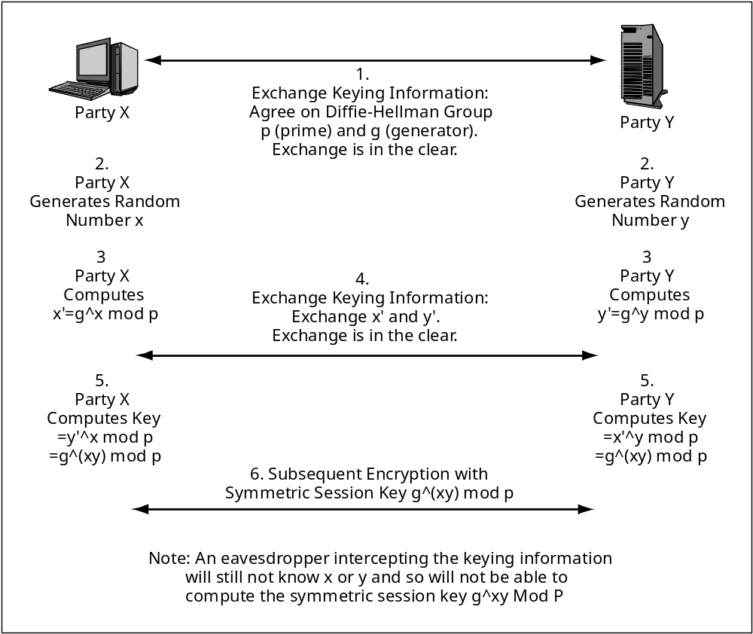
The gory details
Copyright Pearson Prentice-Hall 2009

Slide 18

Selecting methods and parameters
Authentication
Keying (the secure exchange of secrets)
Ongoing communication
Copyright Pearson Prentice-Hall 2009

Slide 19

Consumes nearly all of the dialogues
Message-by-Message Encryption
  Nearly always uses symmetric key encryption
  Already covered
  Public key encryption is too inefficient
Message-by-Message Authentication
  Digital signatures
  Message authentication codes (MACs)
  Also provide message-by-message integrity
Copyright Pearson Prentice-Hall 2009

Slide 20
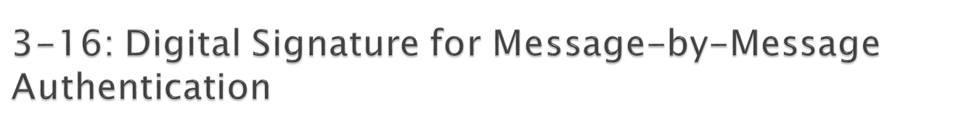
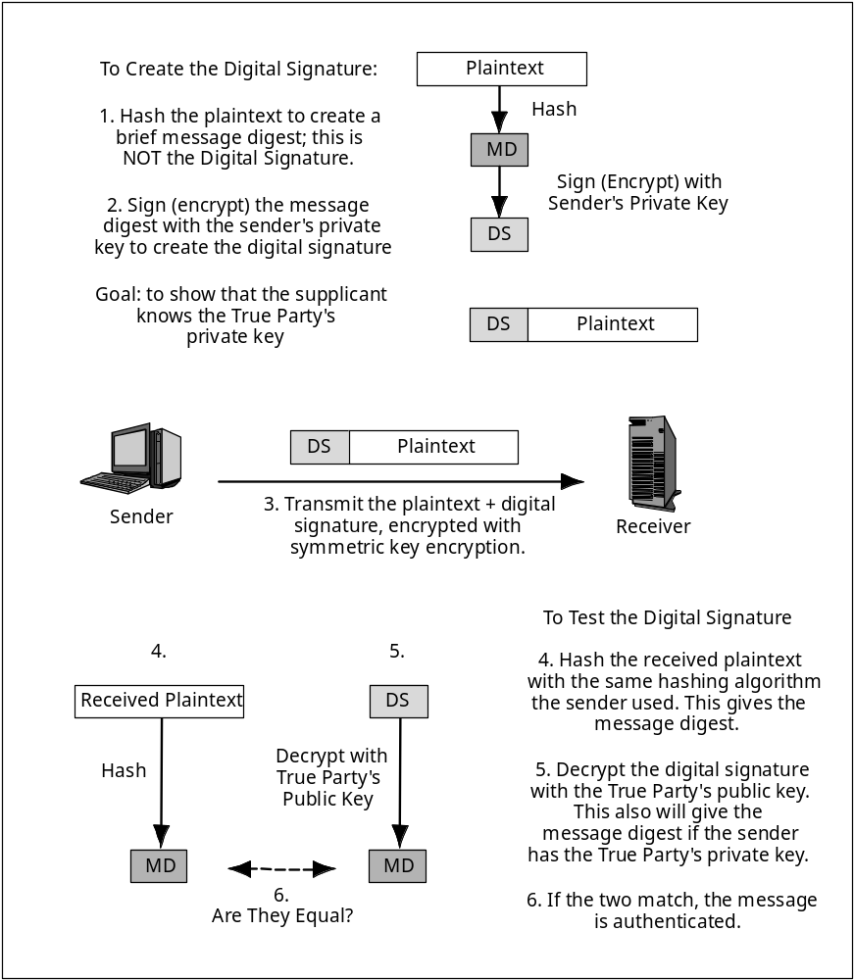
Copyright Pearson Prentice-Hall 2009

Slide 21
Encryption is done to protect the plaintext
It is not needed for message-by-message authentication
Copyright Pearson Prentice-Hall 2009

Slide 22
Copyright Pearson Prentice-Hall 2009

Slide 23

Encryption Goal | Sender Encrypts with | Receiver Decrypts with
Public Key Encryption for Confidentiality | The receiver’s public key | The receiver’s private key
Public Key Encryption for Authentication | The sender’s private key | The True Party’s public key (not the sender’s public key)
Point of frequent confusion
Copyright Pearson Prentice-Hall 2009

Slide 24

Cannot use the sender’s public key
  It would always “validate” the sender’s digital signature
Normally requires a digital certificate
  File provided by a certificate authority (CA)
    The certificate authority must be trustworthy
  Digital certificate provides the subject’s (True Party’s) name and public key
  Don’t confuse digital signatures and the digital certificates used to test digital signatures!
Copyright Pearson Prentice-Hall 2009

Slide 25
Field | Description
Version Number | Version number of the X.509 standard. Most certificates follow Version 3. Different versions have different fields. This figure reflects the Version 3 standard.
Issuer | Name of the Certificate Authority (CA).
Serial Number | Unique serial number for the certificate, set by the CA.
Subject (True Party) | The name of the person, organization, computer, or program to which the certificate has been issued. This is the true party.
Public Key | The public key of the subject (the true party).
Public Key Algorithm | The algorithm the subject uses to sign messages with digital signatures.
Serial number allows the receiver to check if the digital certificate has been revoked by the CA
Certificate provides the True Party’s public key
Copyright Pearson Prentice-Hall 2009

Slide 26
Field | Description
Digital Signature | The digital signature of the certificate, signed by the CA with the CA’s own private key. For testing certificate authentication and integrity. User must know the CA’s public key independently.
Signature Algorithm Identifier | The digital signature algorithm the CA uses to sign its certificates.
Other Fields | …
The CA signs the cert with its own private key so that the cert’s validity can be checked for alterations.
Copyright Pearson Prentice-Hall 2009

Slide 27

Testing the Digital Signature
  The digital certificate has a digital signature of its own
  Signed with the Certificate Authority’s (CA’s) private key
  Must be tested with the CA’s well-known public key
  If the test works, the certificate is authentic and unmodified
Copyright Pearson Prentice-Hall 2009

Slide 28
Checking the Valid Period
  Certificate is valid only during the valid period in the digital certificate (not shown in the figure)
  If the current time is not within the valid period, reject the digital certificate
Copyright Pearson Prentice-Hall 2009

Slide 29
Checking for Revocation
  Certificates may be revoked for improper behavior or other reasons
  Revocation must be tested
  Cannot be done by looking at fields within the certificate
  Receiver must check with the CA
Copyright Pearson Prentice-Hall 2009

Slide 30
Checking for Revocation
  Verifier may download the entire certificate revocation list from the CA
    See if the serial number is on the certificate revocation list
    If so, do not accept the certificate
  Or, the verifier may send a query to the CA
    Requires the CA to support the Online Certificate Status Protocol
Copyright Pearson Prentice-Hall 2009

Slide 31

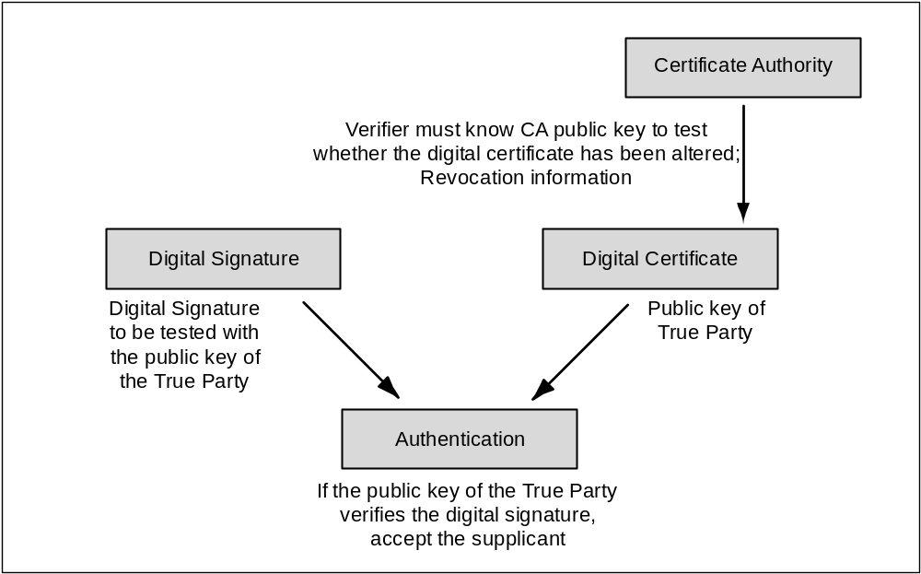
Copyright Pearson Prentice-Hall 2009

Slide 32

Also Brings Message Integrity
  If the message has been altered, the authentication method will fail automatically
Digital Signature Authentication
  Uses public key encryption for authentication
  Very strong but expensive
Key-Hashed Message Authentication Codes
  An alternate authentication method using hashing
  Much less expensive than digital signature authentication
  Much more widely used
Copyright Pearson Prentice-Hall 2009

Slide 33
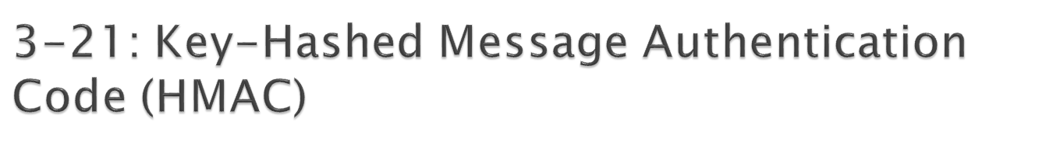
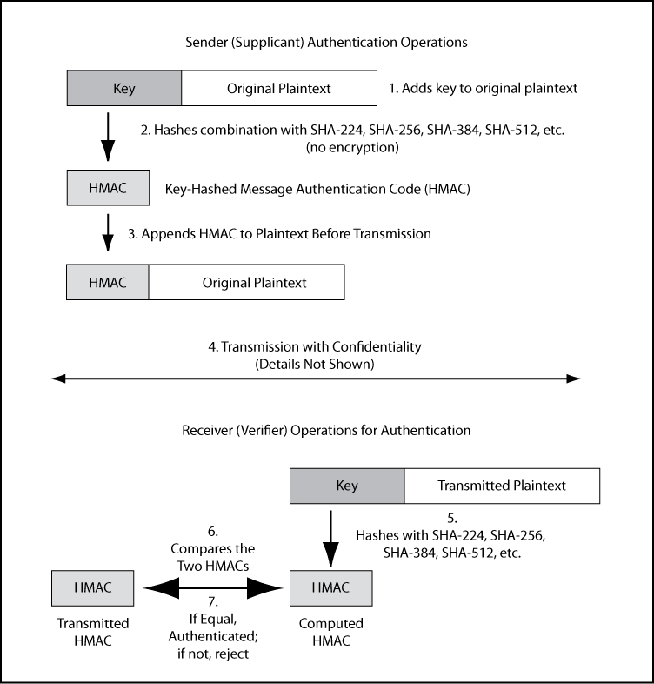
Copyright Pearson Prentice-Hall 2009

Slide 34
As in the case of digital signatures, confidentiality is done to protect the plaintext.
It is not needed for authentication and has nothing to do with authentication.
Copyright Pearson Prentice-Hall 2009

Slide 35
Copyright Pearson Prentice-Hall 2009

Slide 36

Copyright Pearson Prentice-Hall 2009

